Slide 1
Evolutionary Computing
Chapter 2 – The Origins

Slide 2
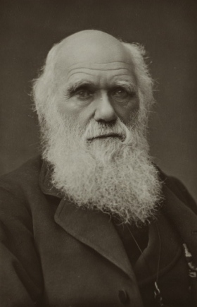
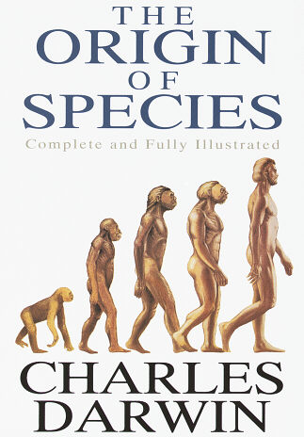
Roots: evolution

Slide 3
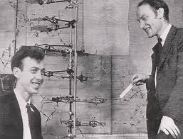
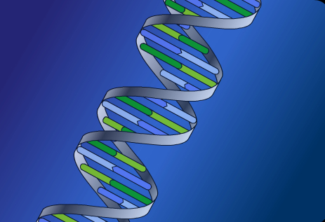
Roots: genetics

Slide 4
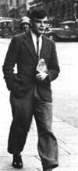
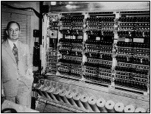
Roots: computers

Slide 5
Question:
what is the name of the other four ”fathers” of Evolutionary Computing?

Slide 6
Motivation for evolutionary computing
Remember the one regarding the evolution of intelligence
– this is “high level”
There is another one regarding (heuristic) problem solving
– this is more practical

Slide 7
Motivation for evolutionary computing
Developing, analyzing, applying problem solving methods a.k.a. algorithms is a central theme in mathematics and computer science
Time for thorough problem analysis decreases
Complexity of problems to be solved increases
Consequence: ROBUST PROBLEM SOLVING technology needed, i.e., algorithms that work on a wide range of problems without much problem specific adjustment

Slide 8
Motivation for evolutionary computing
Nature has always served as a source of inspiration for engineers and scientists
The best problem solver known in nature is:
the (human) brain that created “the wheel, New York, wars and so on” (after Douglas Adams’ Hitch-Hikers Guide)
the evolution mechanism that created the human brain (after Darwin’s Origin of Species)
Answer 1 → neurocomputing
Answer 2 → evolutionary computing

Slide 9
Historical perspective (1/3)
1948, Turing:
proposes “genetical or evolutionary search”
1962, Bremermann:
optimization through evolution and recombination
1964, Rechenberg:
introduces evolution strategies
1965, L. Fogel, Owens and Walsh:
introduce evolutionary programming
1975, Holland:
introduces genetic algorithms
1992, Koza:
introduces genetic programming

Slide 10
Historical perspective (2/3)
1985: first international conference (ICGA)
1990: first international conference in Europe (PPSN)
1993: first scientific EC journal (MIT Press)
1997: launch of European EC Research Network EvoNet
2003: first comprehensive EC textbook (Eiben & Smith)

Slide 11
Historical perspective (3/3)
EC in the early 21st Century:
4 major EC conferences, about 10 small related ones
5 scientific core EC journals (ECJ, ToEC, GPEM, EI, SEC)
1000+ EC-related papers published last year (estimate)
uncountable (meaning: many) applications
uncountable (meaning: ?) consultancy and R&D firms use EC
part of many university curricula

Slide 12
Conference history

Slide 13
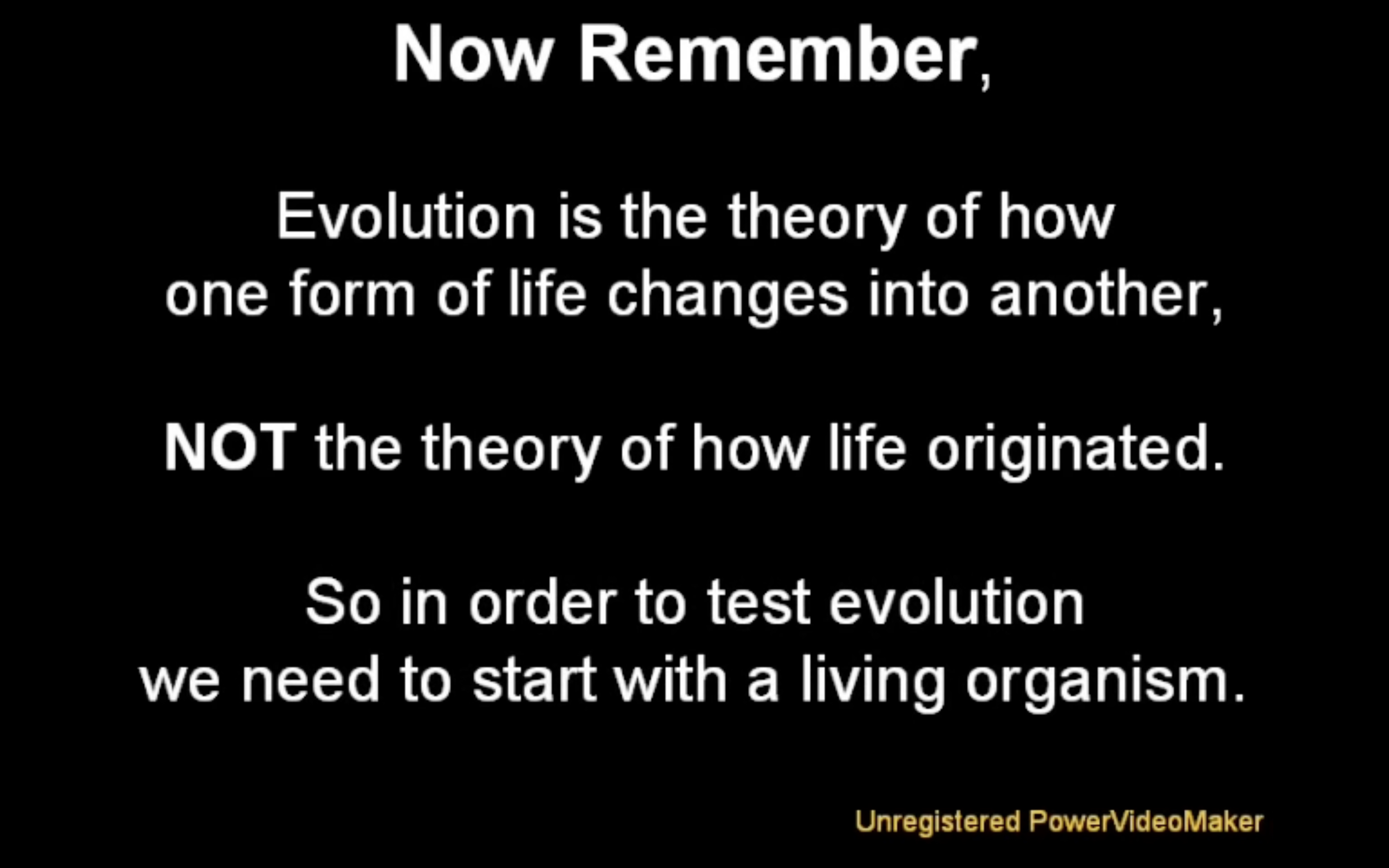
How evolution really works (9’58’’)
screenshot
https://www.youtube.com/watch?v=SeTssvexa9s

Slide 14
Darwinian Evolution: Survival of the fittest
All environments have finite resources
(i.e., can only support a limited number of individuals)
Life forms have basic instinct/ lifecycles geared towards reproduction
Therefore some kind of selection is inevitable
Those individuals that compete for the resources most effectively have increased chance of reproduction
Note: fitness in natural evolution is a derived, secondary measure, i.e., we (humans) assign a high fitness to individuals with many offspring

Slide 15
Darwinian Evolution: Diversity drives change
Phenotypic traits:
Physical & behavioural differences that affect response to environment
Partly determined by inheritance, partly by factors during development (nature vs. nurture)
Unique to each individual, partly as a result of random changes
If phenotypic traits:
Lead to higher chances of reproduction
Can be inherited
then they will tend to increase in subsequent generations, leading to new combinations of traits …

Slide 16
Quote (D. Dennett)
“If you have variation, heredity, and selection, then you must get evolution”

Slide 17
Darwinian Evolution: Summary
Population consists of diverse set of individuals
Combinations of traits that are better adapted tend to increase representation in population
Individuals are “units of selection”
Variations occur through random changes yielding constant source of diversity, coupled with selection means that:
Population is the “unit of evolution”
Note the absence of “guiding force”

Slide 18
Quote (John Maynard Smith)
“So far, we have been able to study only one evolving system and we cannot wait for interstellar flight to provide us with a second. If we want to discover generalizations about evolving systems, we have to look at artificial ones.”

Slide 19
Adaptive landscape metaphor (Wright, 1932)
Can envisage population with n traits as existing in a n+1-dimensional space (landscape) with height corresponding to fitness
Each different individual (phenotype) represents a single point on the landscape
Population is therefore a “cloud” of points, moving on the landscape over time as it evolves – adaptation

Slide 20
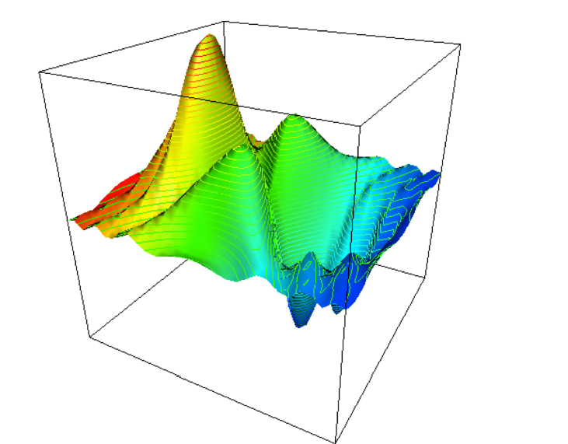
Adaptive landscape metaphor (Wright, 1932)

Slide 21
Adaptive landscape metaphor (cont’d)
Selection “pushes” population up the landscape
Genetic drift:
random variations in feature distribution
(+ or -) arising from sampling error
can cause the population “melt down” hills, thus crossing valleys and leaving local optima

Slide 22
Genetics
The information required to build a living organism is coded in the DNA of that organism
Genotype (DNA inside) determines phenotype (outside)
The mapping genes → phenotypic traits is very complex
One gene may affect many traits (pleiotropy)
Many genes may affect one trait (polygeny)
Small changes in the genotype lead to small changes in the organism (e.g., height, hair colour)

Slide 23
Genes and the Genome
Genes are encoded in strands of DNA called chromosomes
In most cells, there are two copies of each chromosome (diploid chsomosomes)
The complete genetic material in an individual’s genotype is called the genome
Within a species, most of the genetic material is the same
As for humans:
human genome contains 3 billion DNA base pairs (with 20,000 genes)
were 99.9 percent identical in every person
https://www.genome.gov/17516714/2006-release-about-whole-genome-association-studies

Slide 24
Genetics: Homo Sapiens
Human DNA is organised into chromosomes
Human body cells contain 23 pairs of chromosomes which together define the physical attributes of the individual:

Slide 25
Genetics: Reproductive Cells
Gametes (sperm and egg cells) contain 23 individual chromosomes rather than 23 pairs
Cells with only one copy of each chromosome are called haploid
Gametes are formed by a special form of cell splitting called meiosis
During meiosis the pairs of chromosome undergo an operation called crossing-over
Note: biologists use “crossing-over”, EC folks use “crossover”

Slide 26
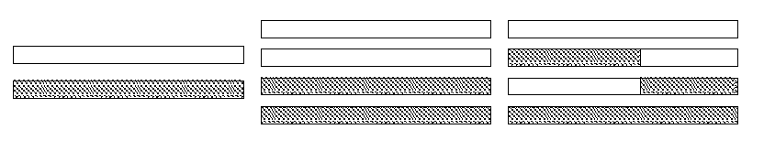
Genetics: Crossing-over during meiosis
Chromosome pairs align and duplicate
Inner pairs link at a centromere and swap parts of themselves
Outcome is one copy of maternal/paternal chromosome plus two entirely new combinations
After crossing-over one of each pair goes into each gamete

Slide 27
Genetics: Mutation
Occasionally some of the genetic material changes very slightly during crossing-over (replication error)
This means that the child might have genetic material information not inherited from either parent
This can be
catastrophic: offspring is not viable (most likely)
neutral: new feature does not influence fitness
advantageous: strong new feature occurs
Redundancy in the genetic code forms a good way of error checking

Slide 28
Genetics: Fertilisation
Sperm cell from Father
Egg cell from Mother
New person cell (zygote)

Slide 29
Genetics: After fertilisation
New zygote rapidly divides creating many cells all with the same genetic contents
Although all cells contain the same genes, depending on, for example where they are in the organism, they will behave differently
This process of differential behaviour during development is called ontogenesis
All of this uses, and is controlled by, the same mechanism for decoding the genes in DNA

Slide 30
Genetics: Genetic code
All proteins in living beings on earth are composed of sequences built from 20 different amino acids
DNA is built from four nucleotides in a double helix spiral: purines A,G; pyrimidines T,C
Triplets of these from codons, each of which codes for a specific amino acid
Much redundancy:
purines complement pyrimidines
the DNA contains much rubbish
4³=64 codons code for 20 amino acids
genetic code = the mapping from codons to amino acids
For all natural life on earth, the genetic code is the same !

Slide 31
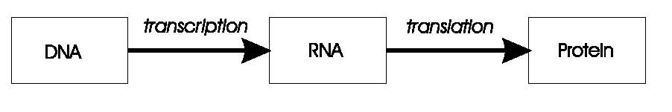
Genetics: Transcription, translation
A central claim in molecular genetics: only one way flow
Genotype Phenotype
Genotype Phenotype
Lamarckism (saying that acquired features can be inherited) is thus wrong!
But we can use it in artificial evolution!

Slide 32
Important points
Several historical ‘dialects’ in EC, e.g.,
Genetic Algorithm,
Evolution Strategy,
Evolutionary Programming,
Genetic Programming, …
Umbrella term for the principal algorithm: Evolutionary Algorithm
Name of the field: Evolutionary Computing (or Computation)
Enveloping fields: bio-inspired computing, natural computing, computational intelligence, artificial intelligence
Biological inspiration & terminology
Not necessarily biologically plausible
Bio-chemical grounding is missing (matter matters!)
Simplified mechanisms
Biologically impossible or non-existing mechanisms are OK for applications

Slide 33
